Slide 1
Today’s Topics
Prelim cum Mains Preparation
7 days duty: How to read theHindu

Slide 2
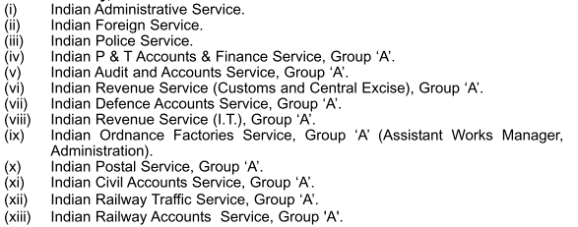
23 Services under UPSC Civil services exam (CSE)

Slide 3
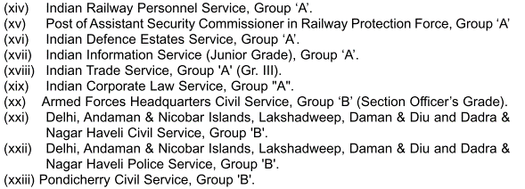
23 Services under UPSC Civil services exam (CSE)

Slide 4
UPSC Age counted on 1st August, Min. age @21
Category
General
OBC
Age
32
35
Attempt
SC/ST
37
6
9
Upper age

Slide 5
Education qualification?
Prelims
August
Mains
December
Interview
April-June
MCQ
Descriptive
Prelim Result
Mid-October
A Detailed Application form (DAF)
Wherein you’ve to submit copy of grad. certificate/marksheeet
No documents have to be attached here
In other words, you may apply for UPSC in last year/ last semester of college, IF you’re going to get marksheet by October

Slide 6
Prelims (usually in August), MCQ Paper set in English & Hindi
Paper 1 (General Studies)
200 marks | 2 hours
Paper 2 (Aptitude / CSAT)
Only 33% qualifying marks, Not counted for result
Negative marks for wrong answers
Prelim result decided from this score
200 marks | 2 hours
Negative marks for wrong answers
Notes:
2015 it is on 23rd August

Slide 7
Mains Exam – descriptive paper (usually in December)
Not counted in Merit
Indian Language
Essay Paper
GS1 to 4
Optional (1 subject, 2 papers)
Compulsory English
Counted in Merit
Each has total 300 marks, need to score min. 25%
Each paper has 250 marks, score counted in Final Merit list
For detailed syllabus, refer to Page 5 of notification click me

Slide 8
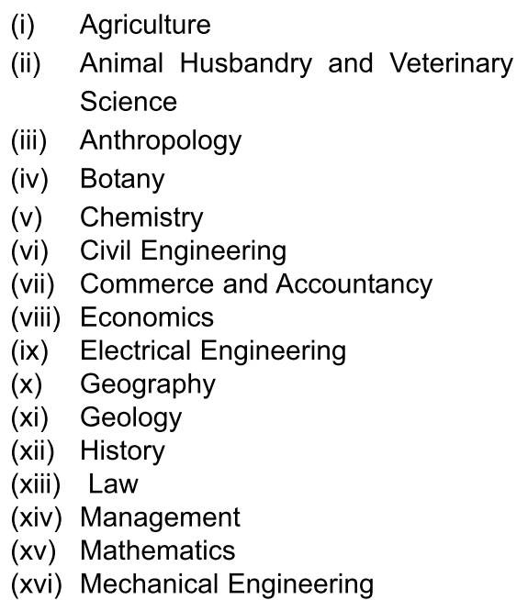
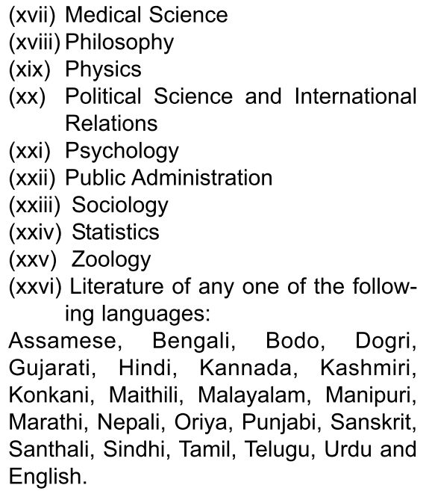
Pick any 1 out of following optional subjects for mains

Slide 9
medium doubts
Optional
Mech. Engineering
Essay & GS (1-4) papers
Suppose he decided English medium
Will have to write in English only.
Optional
Gujarati literature
Essay & GS (1-4) papers
Suppose he decided English medium
Will have to write in this in Gujarati script only.
Mains
Interview
Suppose he wrote in English
He can give interview in English, Hindi, Guj. Depending on his choice, but has to declare in DAF (Mains-application form)

Slide 10
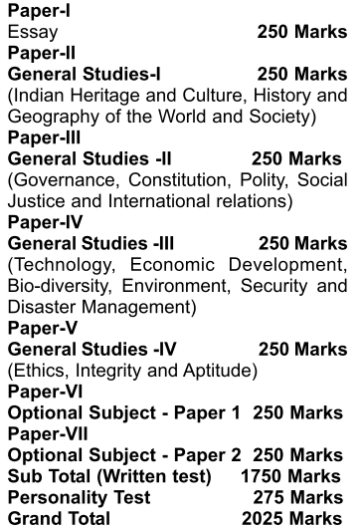
Final merit = Marks in Mains + Interview
Prelim exam is only for shortlisting candidates for the mains exam.
Its marks are not counted in the final merit list.
Final merit list = Mains + interview

Slide 11
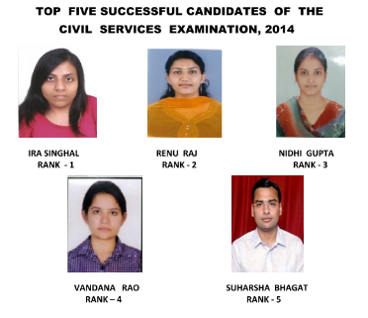
UPSC-2014
You’re here
JBPS: Just because papa said

Slide 12
GS for a “lover”: G-E-P-H-S-C
Salient Characteristics
“Scavenging Material” without digesting / processing
No notes making- or just copy paste / save in Evernote
Competitive magazine & Websites & wiki. Hindu
Forum debater, cutoff, pattern change, optional removal
Mood based fragmented prep.
Social functions, cricket, movies
No mocks, no analysis
Economy
Science Tech
Current
History
Geography
Polity

Slide 13

GS for a “Killer”
Economy
Science Tech
Current
History
Geography
Polity
Agriculture
Environment
Culture
IR/Defense

Slide 14
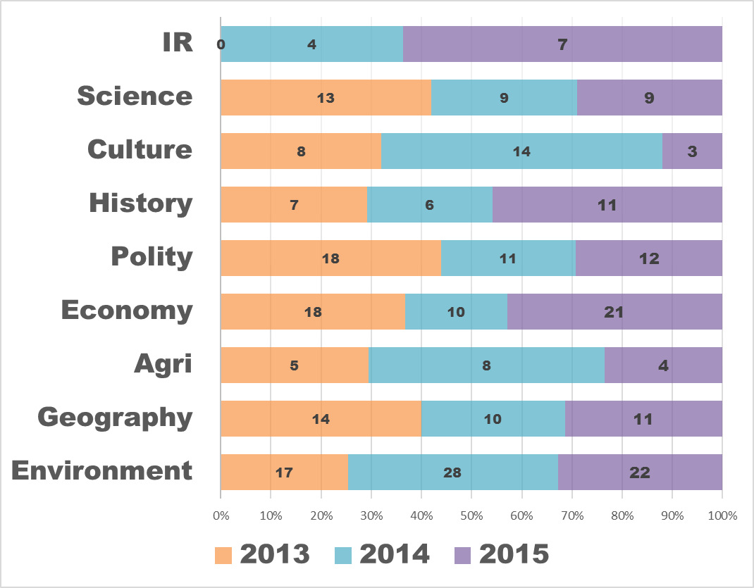
Brief analysis of last 3 Prelim papers
preCSAT: PIN
Sports, PIN Easy to moderate
Pinch higher than NCERT
Lunacy gone. 2/3 solvable.
Freedom struggle getting bit tougher
Medieval making comeback
No current. Mostly Laxmikanth
Easy to moderate, mostly theory, contemporary
Crazy physical
Moderate to difficult but not IFoS-exclusive
Mostly map based, Moderate
Easy to moderate.
Nothing IFoS-exclusive

Slide 15
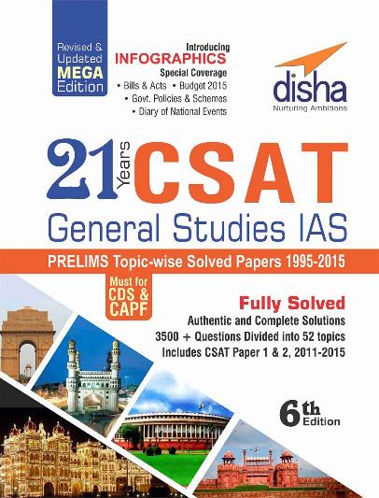
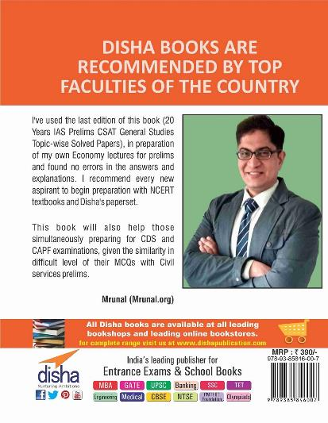

Observe the nature of prelim question (topicwise)
CLICK TO Buy online, Pay on delivery
Hindi Edition
English Edition
Kindle Edition

Slide 16
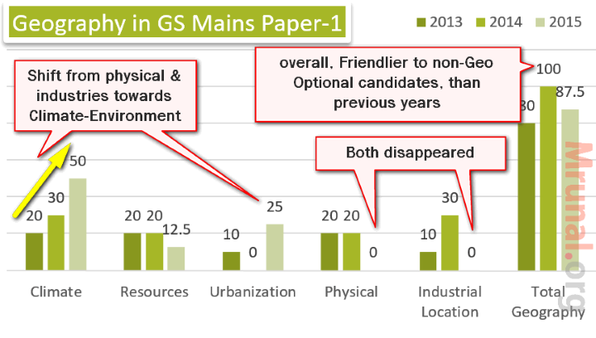
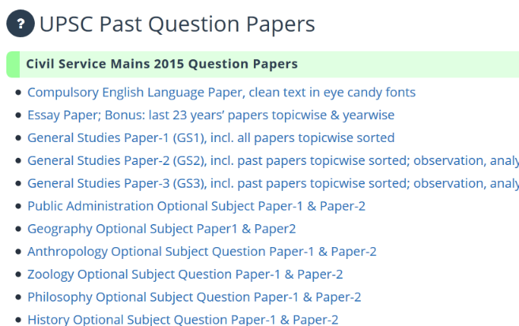
Analyze the nature of past Mains questions
Mrunal.org/DOWNOAD
topicwise Qs in GS1-3

Slide 17
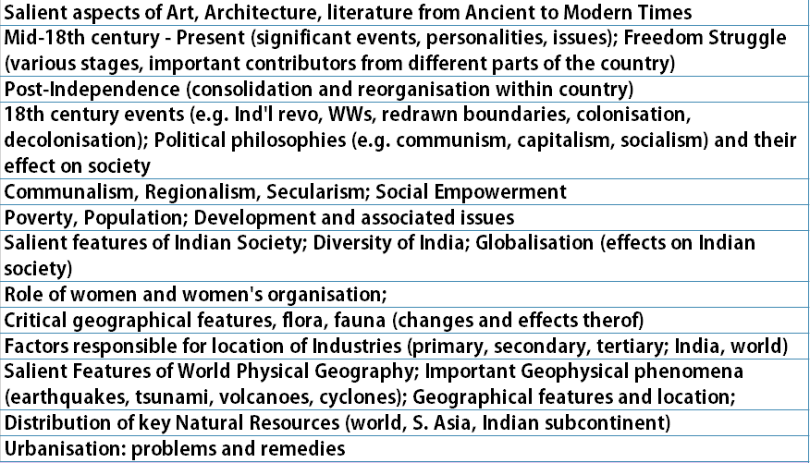
Syllabus of GS1
History- World
History- India: before & after freedom
Sociology
Women
Poverty, Urbanization
Geography-physical, India, world

Slide 18
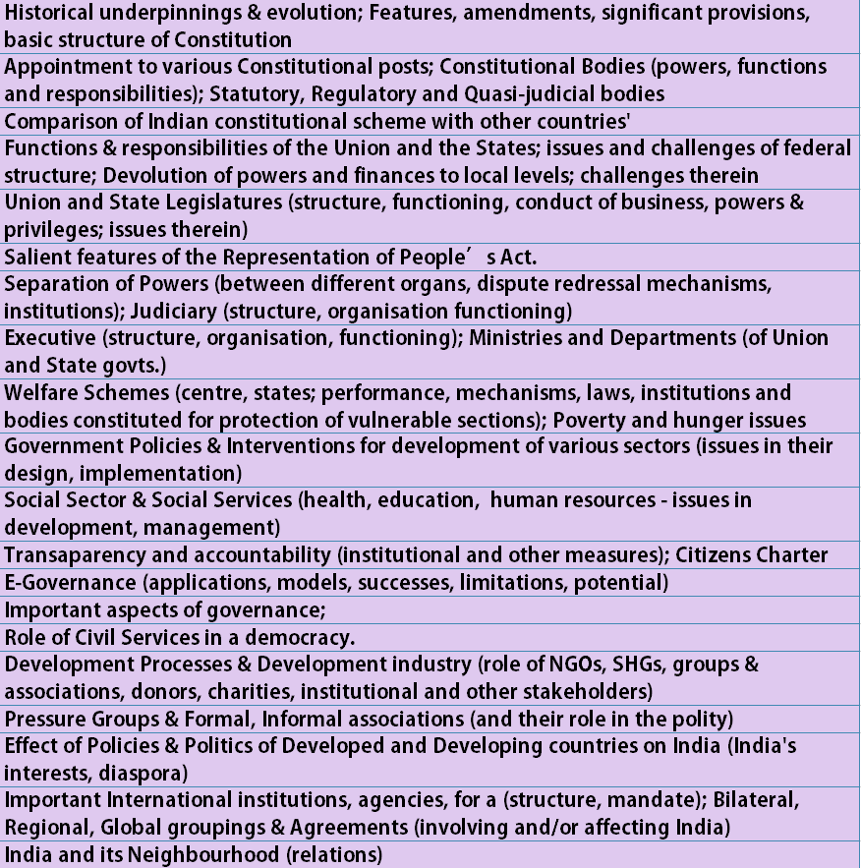
Syllabus of GS2
Polity: comparing Constitution, RPA
Scheme, Policies
Governance, e-Gov.
Civil service, pressure groups, NGO
IR: diplomacy, diaspora

Slide 19
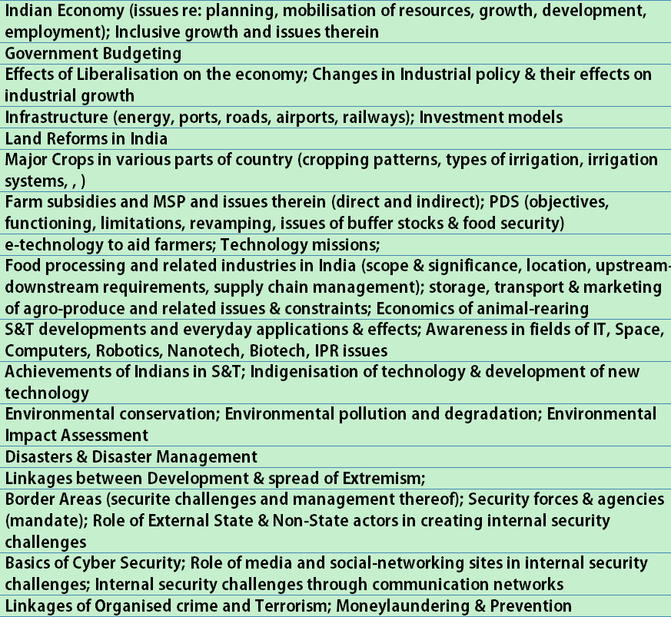
Syllabus of GS3
Economy & infra.
Agriculture: crops, FPI
S&T
Environment, Disaster
Security, border

Slide 20
Whenever reading a book/magazine/newspaper
Prelims
Mains
Interview
Fodder
Cost: benefit …x
PIN: Person, place, books, authors, awards, BizGK, Sports (for NON-UPSC MCQ & UPSC Interview)

Slide 21

GS for a “Killer” doing PRELIMS-CUM-MAINS Prep.
GSM1,2,3
GSM1,2,3
GSM1,3
GSM1, 2, 3
GSM1,2
Economy
Science Tech
Current
History
Geography
Polity
Agriculture
Environment
Culture
IR/Defense
GSM1,2 (Polity, IR)
GSM 2,3
GSM 1, 2, 3
Notes:
Killing is as easy as breathing.

Slide 22
Science “tech”
Public Health (GSM2)
Defense
Biotech
Genetic Engineering
Pharma- IPR
IT (GS2, 3)
Nanotech
Jt. Exercises
Inventions
Space
Universe
ISRO,NASA
GS2-E-gov.
GS3-Security
Innovation
Schemes-policies
Engg./R&D
Energy / pollution
Agri., Automobile
defense

Slide 23
Brief analysis of last 3 Prelim papers
preCSAT: PIN
Sports, PIN Easy to moderate
Pinch higher than NCERT
Lunacy gone. 2/3 solvable.
Freedom struggle getting bit tougher
Medieval making comeback
No current. Mostly Laxmikanth
Easy to moderate- mostly theory, contemporary
Crazy physical
Easy to moderate.
Nothing IFoS-exclusive
Mostly map based, Moderate
Easy to moderate.
Nothing IFoS-exclusive

Slide 24

Public health: Why read Hindu?
CSE-2015
42. H1N1 virus is associated with
(a) AIDS
(b) Bird flu
(c) Dengue
(d) Swine flu

Slide 25
Public health: Why read Hindu?
CSE-2015
42. H1N1 virus is sometimes mentioned in the news with reference to which one of the following diseases?
(a) AIDS
(b) Bird flu
(c) Dengue
(d) Swine flu
TheHindu 5th February 2015
In most GK/GS books/Manuals, this H1N1= Swine flu info. is missing. Therefore, you’ve to read Hindu

Slide 26
Public health – why read Hindu?
CSE-2015
67. Among the following, which were frequently mentioned in the news for the outbreak of Ebola virus recently?
(a) Syria and Jordan
(b) Guinea, Sierra Leone and Liberia
(c) Philippines and Papua New Guinea
(d) Jamaica, Haiti and Surinam
Hindu 5th August 2015

Slide 27
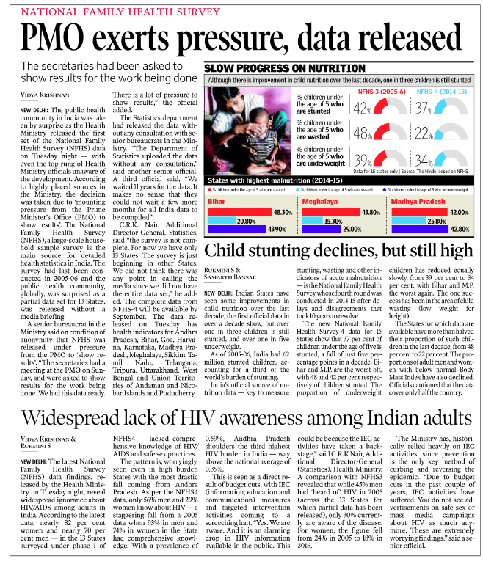

Doesn’t mean you’ve to read everything!
Economic Survey will cover the highlights again. Better get it from there.

Slide 28
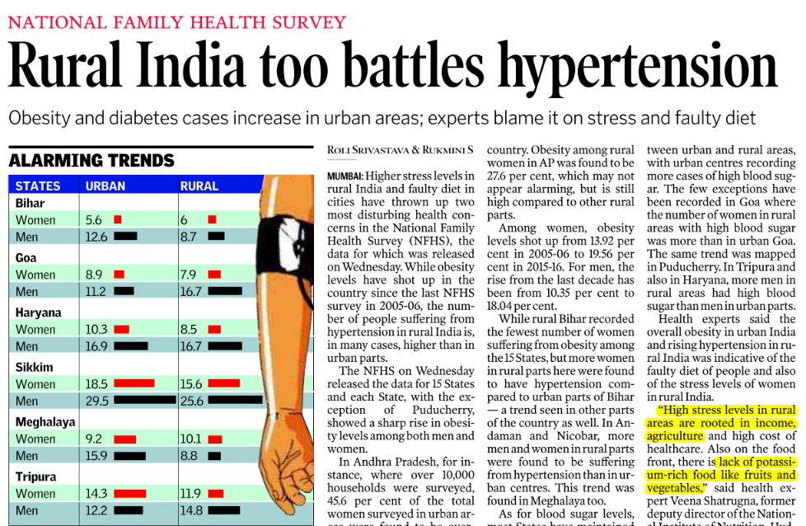
Although doesn’t mean you should completely ignore
A&R type

Slide 29
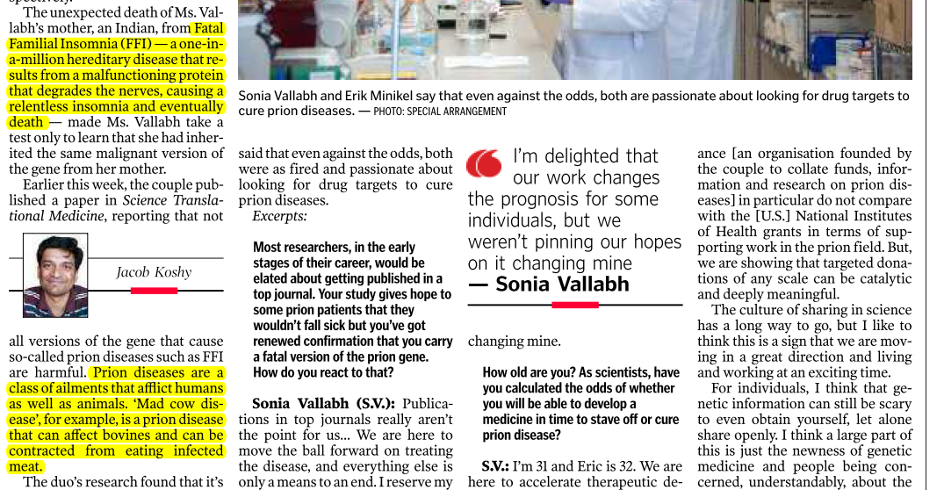
Always lookout for “Definitions” and “terminologies”

Slide 30
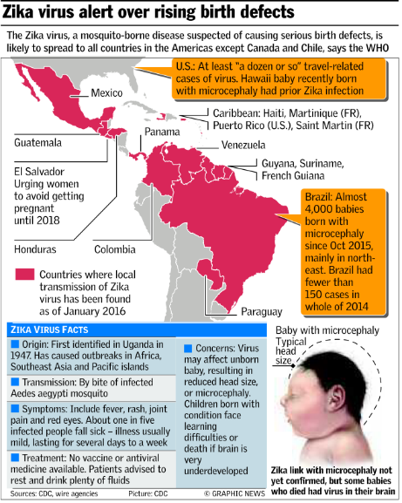
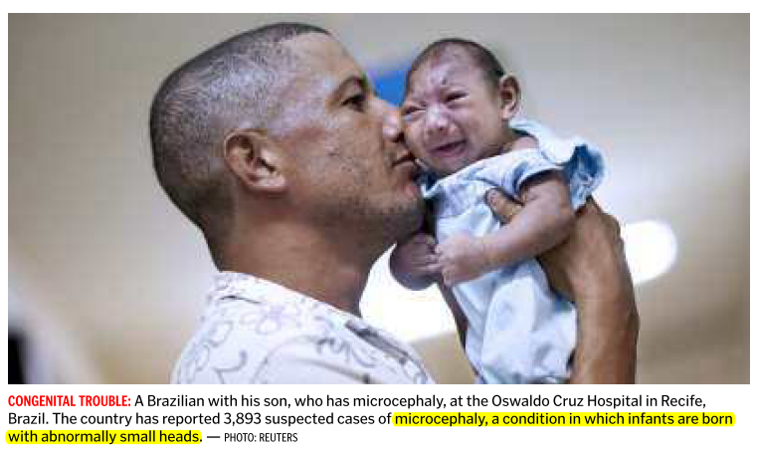
First Ebola, now Zika Virus
Meaning of Microcephaly
Countries affected
Name of mosquito

Slide 31
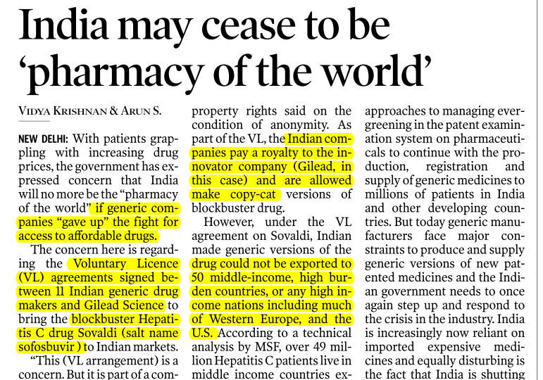



Pharmacy / medicine related

Slide 32
Science “tech”
Public Health (GSM2)
Defense
Biotech
Genetic Engineering
Pharma- IPR
IT (GS2, 3)
Nanotech
Jt. Exercises
Inventions
Space
Universe
ISRO,NASA
GS2-E-gov.
GS3-Security
Innovation
Schemes-policies
Engg./R&D
Energy / pollution
Agri., Automobile
defense

Slide 33
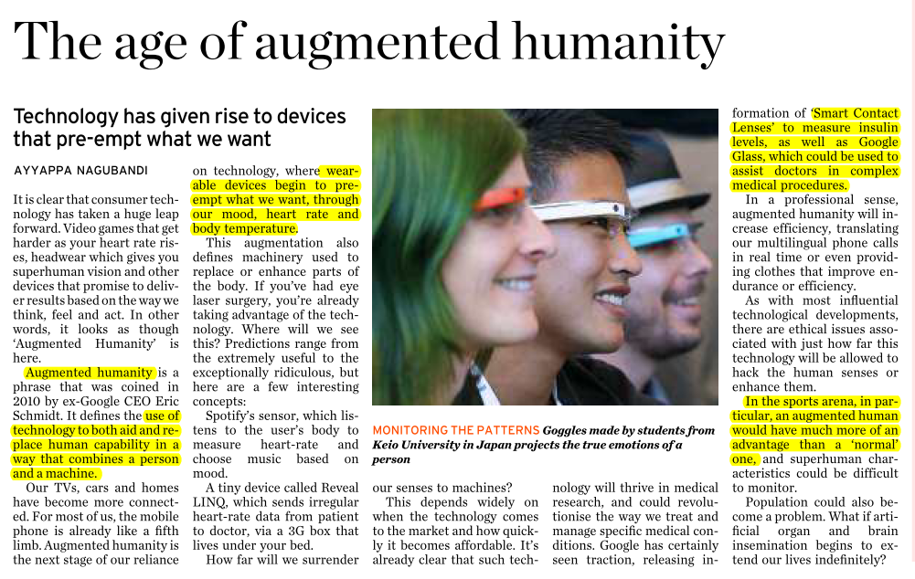

IT related – pre and Essay
Google the principle
Ethical dimension
Notes:
This is why you’ve to read hindu.

Slide 34
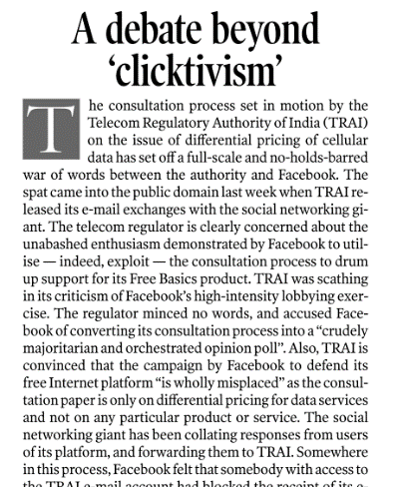
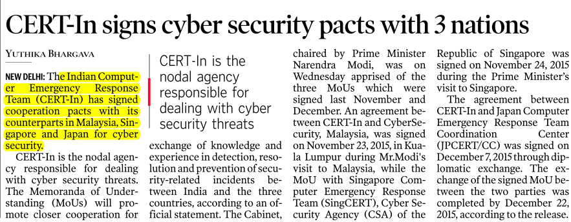

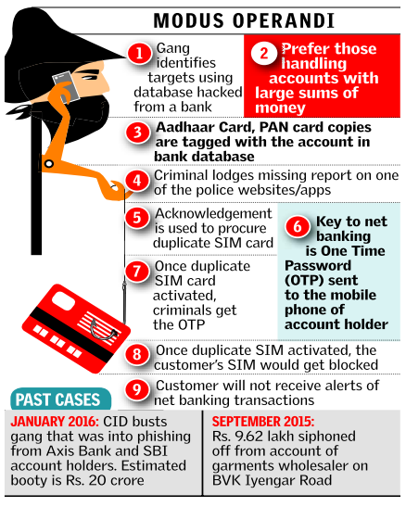


Once you get the basics, no need for ball by ball

Slide 35
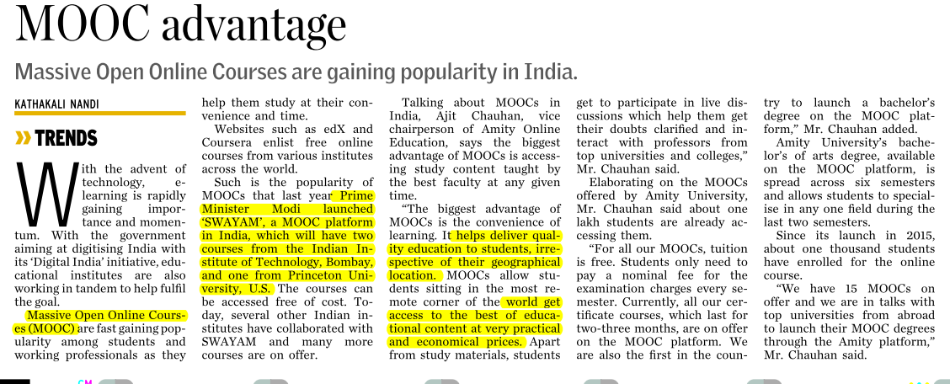

IT / E-governance in HRD

Slide 36
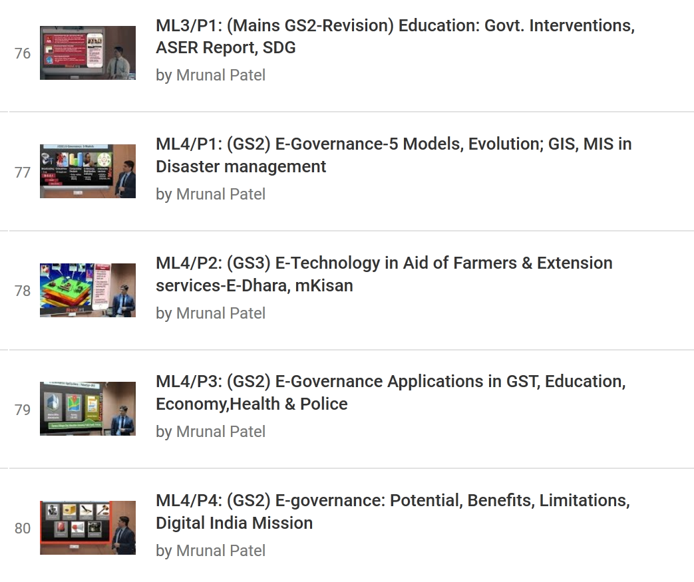
GSM2: E-governance ; GSM3: E-tech in aid for farmers
youtube.com/user/TheMrunalPatel/playlists

Slide 37
Science “tech”
Public Health (GSM2)
Defense
Biotech
Genetic Engineering
Pharma- IPR
IT (GS2, 3)
Nanotech
Jt. Exercises
Inventions
Space
Universe
ISRO,NASA
GS2-E-gov.
GS3-Security
Innovation
Schemes-policies
Engg./R&D
Energy / pollution
Agri., Automobile

Slide 38
Why read theHindu?
CSE-2015
100. Indira Gandhi Prize for Peace, Disarmament and Development for 2014 was given to ____?
(a) Bhabha Atomic Research Centre
(b) Indian Institute of Science
(c) Indian Space Research Organization
(d) Tata Institute of Fundamental research
Answer is "C" ISRO as per TheHindu Nov. 2014

Slide 39
Doesn’t mean always direct Qs come
CSE-2015
80. 'IceCube', a particle detector located at South Pole:
1. It is the world's largest neutrino detector, encompassing a cubic kilometre of ice.
2. It is a powerful telescope to search for dark matter.
3. It is buried deep in the ice.
Correct Statement
(a) 1 only (b) 2 & 3 only (c) 1 & 3 only (d) 1, 2& 3

Slide 40
Although Q. was difficult
CSE-2015
1st statement is right as per Hindu Jan.2015 http://www.thehindu.com/news/national/students-to-take-virtual-tour-of-south-pole/article6781535.ece
2nd statement is right as per http://phys.org/news/2013-11-world-largest-particle-detector-icecube.html
3rd statement is right as per Hindu 2013 From <http://www.thehindu.com/sci-tech/science/highenergy-neutrinos-from-alien-sources-found/article5397965.ece>
Hence answer "D" all correct.

Slide 41

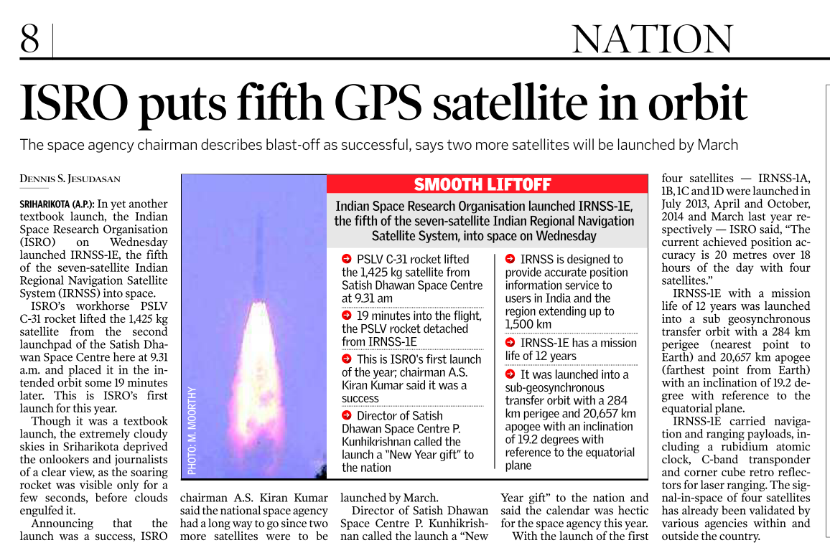

Space: ISRO (2016, Jan)

Slide 42
Notes making
ISRO
IRNSS- Desi GPS; 7 satellite: 4 done, this is 5th. PSLV-C31 rocket (is it solid or liquid fuel? Is the satellite geostationary? google)
Rubidium atomic clock (WHY not spring/quartz clock? – Google)
PIN: ISRO Chairman A.S.Kiran Kumar
Perigee= nearest to earth; Apogee= farthest from earth
IFoS Mains-2015: In the light of recent achievements of ISRO, highlight the development of space technology. (15 Marks) -- desi GPS as a fodder point
Interview: why not rely on American/Russian system? (Ans. Strategic, Economic angles)
Notes:
As such given in books- perigee, apogee.
Triangulating time singals- to Pinpoint location
Iraq war- misguided.

Slide 43
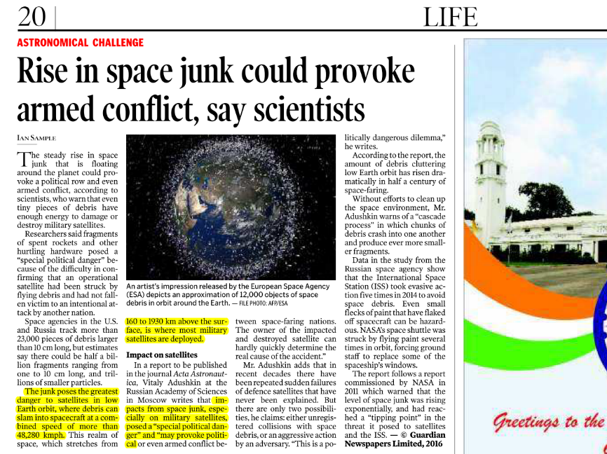
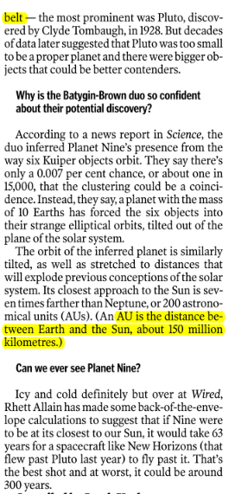
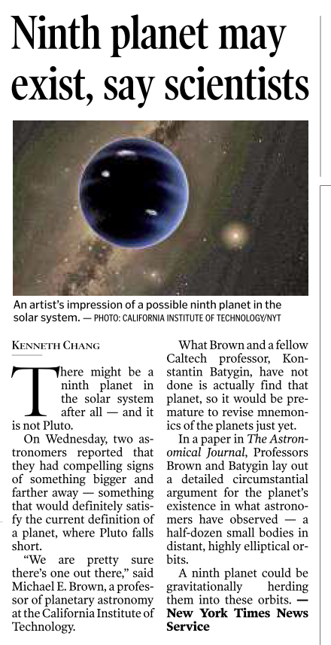




Space: Universe (2016, Jan)

Slide 44
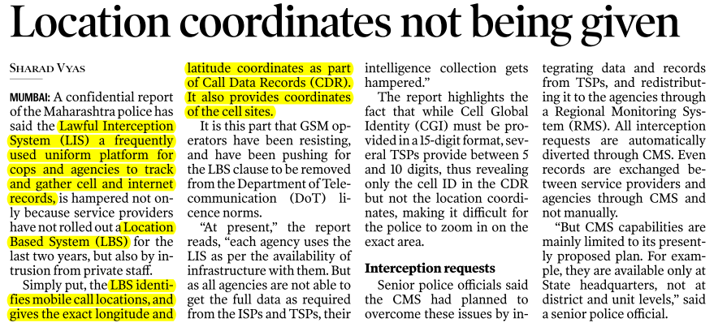

Always lookout for “Definitions” and “terminologies”

Slide 45
Science “tech”
Public Health (GSM2)
Defense
Biotech
Genetic Engineering
Pharma- IPR
IT (GS2, 3)
Nanotech
Jt. Exercises
Inventions
Space
Universe
ISRO,NASA
GS2-E-gov.
GS3-Security
Innovation
Schemes-policies
Engg./R&D
Energy / pollution
Agri., Automobile

Slide 46
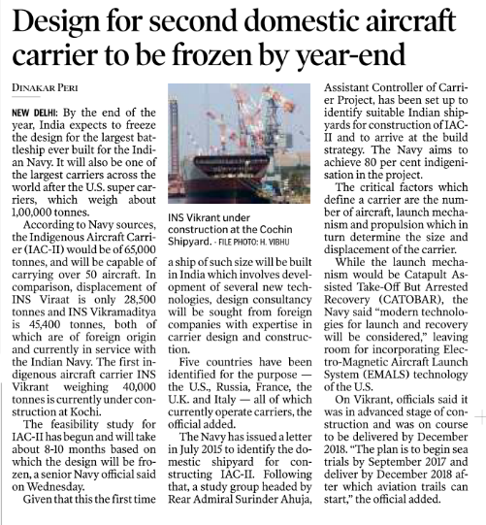

Defense: aircraft carriers (Jan 2016)
Virat (foreign)
Vikramaditya (Foreign)
Vikrant (Desi)
IAC-II (Desi)- largest.
Fodder- for India as a global power
Notes:
Make in india.

Slide 47
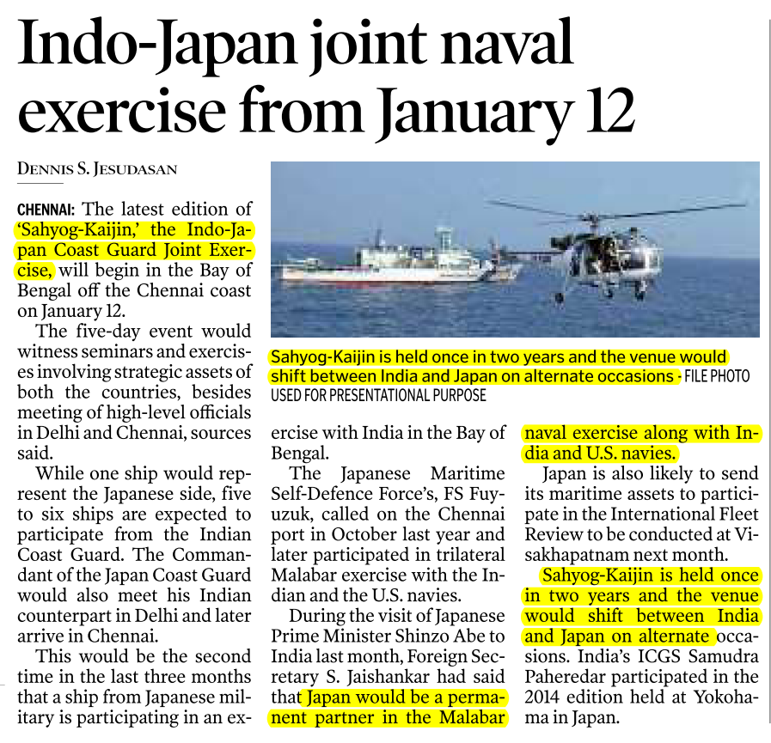
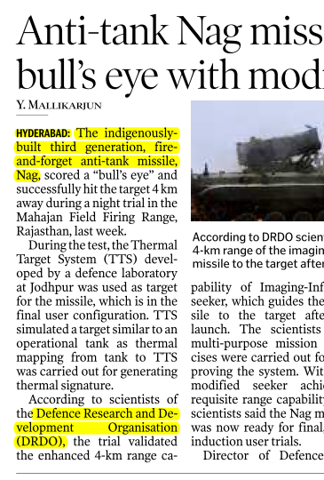


Defense (Jan’16)
Coast guard and not (navy+airforce).
Don’t be assume by headline and photos
JICA= infra + this is strategic
India as a global power, UNSC contender, indigenous Development of technology
Match the following
Notes:
Fodder for Defense cooperation.

Slide 48
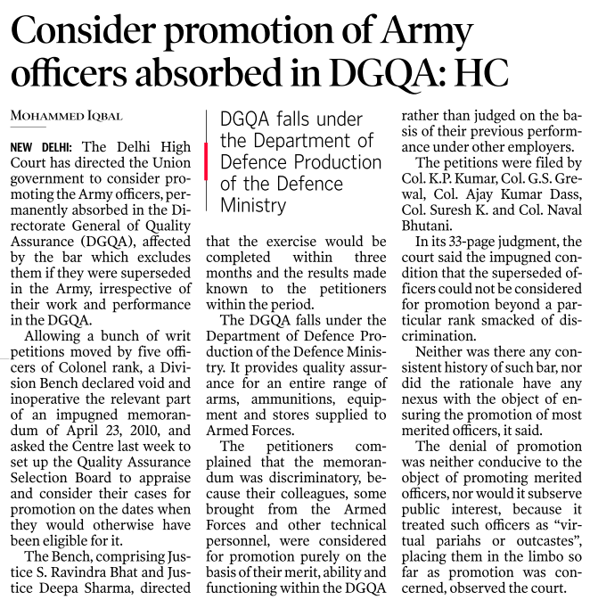
Doesn’t mean every defense news is important

Slide 49
Science “tech”
Public Health (GSM2)
Defense
Biotech
Genetic Engineering
Pharma- IPR
IT (GS2, 3)
Nanotech
Jt. Exercises
Inventions
Space
Universe
ISRO,NASA
GS2-E-gov.
GS3-Security
Innovation
Schemes-policies
Engg./R&D
Energy / pollution
Automobile
Agri.

Slide 50
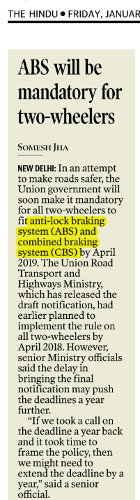
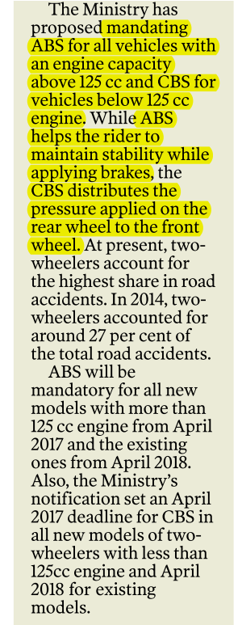

Engineering
If you’re an engineer
Doesn’t matter which branch.

Slide 51
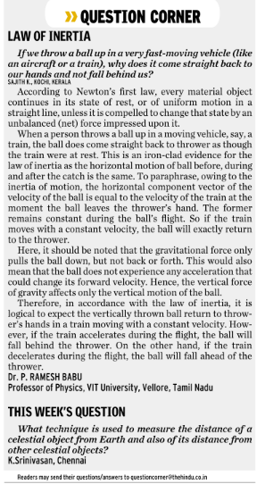
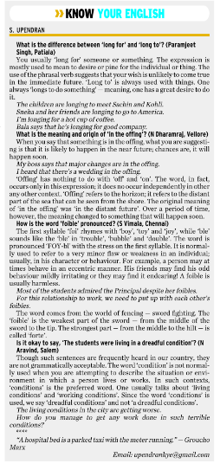
Day to day Science and English
Notes:
Usually on Monday?

Slide 52
For Science theory: NCERTs
Class | PHYSICS | Chemistry | Biology
7 | 4, 13, 14 & 15 | 5 & 6 | 1,2,10; 11 & 12
8 | 11 to 16 | 3 to 6 | 2, 8, 9 & 10
9 | 8 to 12 | 1 to 4 | 5,6,7 & 13
10 | 10, 12 & 13 | 1 to 5 | 6 to 11
11 | 1,5,8 | 1,14 | 2 to 5
12 | 15 | 14,16 | 4,5 then 7 to 16
Green cells= Environment related, must read
+ Psychology Ch4, Glossary
Available @Mrunal.org/download

Slide 53
Why read science NCERT? UPSC -CDS 2014(i)
Deficiency of ___ is/are responsible for weakening of bones?
Calcium
Phosphorus
Nitrogen
Carbon
1 and 2 only
1 only
1, 2 and 3
4
NCERT Class 9 Ch6 Page 9

Slide 54
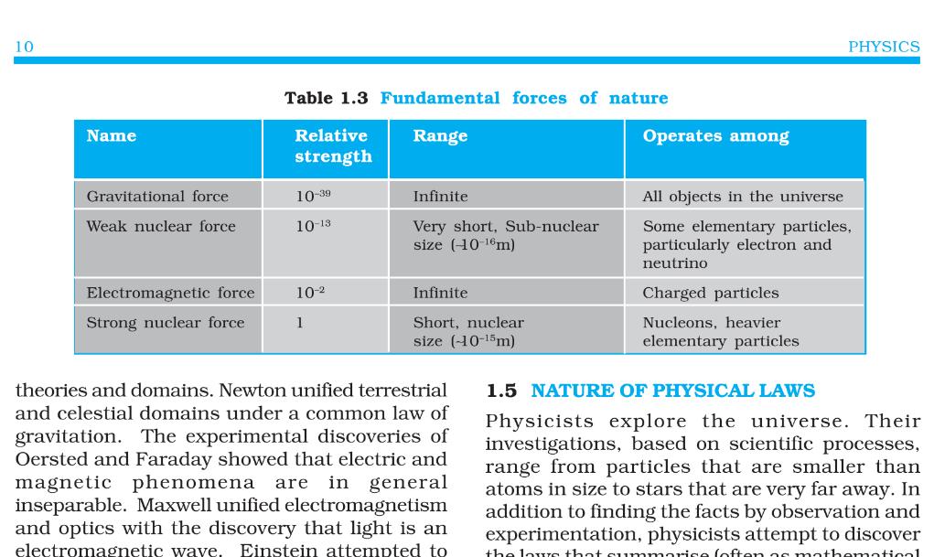
NCERT class 11, Physics Ch.1 page 10

Slide 55
Why (selective) reading of Class11, 12?
CSE-2013
Find Wrong statement about four classes, viz, gravity, electromagnetism, weak nuclear force and strong nuclear force.
Gravity is the strongest of the four
Electromagnetism act only on particles with an electric charge
Weak nuclear force causes radioactivity
Strong nuclear force holds protons and nutrons inside the nuclear of an atom.

Slide 56
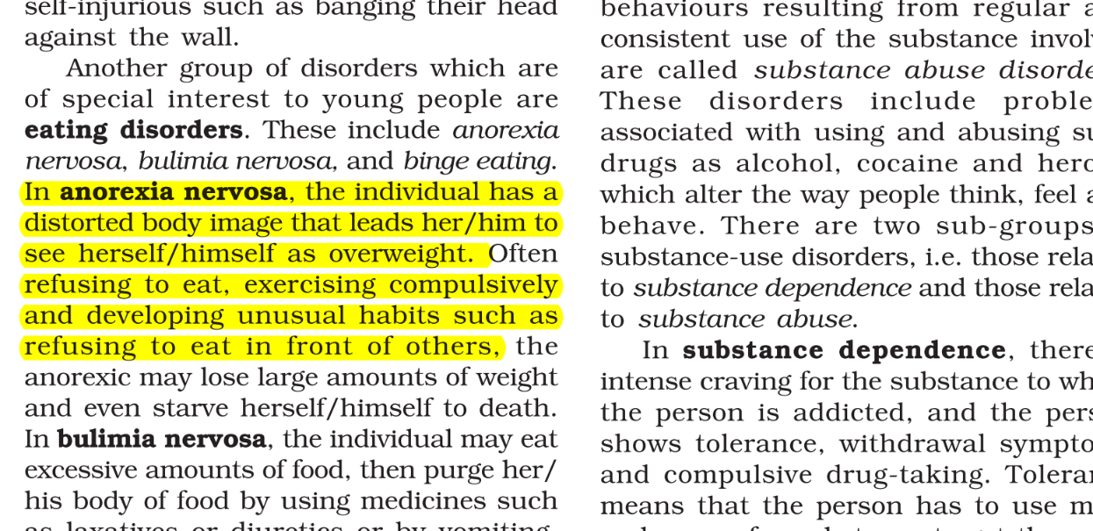
NCERT Class 12 Psychology Ch.4

Slide 57
Why selectively read NCERT Class11, 12
CDS 2014 (1)
People suffering from anorexia nervosa
Develop paralysis
Show poor reflex
Cannot speak properly
Eat very little and fear gaining weight
NCERT 12 Psychology Ch.4 Page 16 +Glossary
Lucent/GS Manual

Slide 58
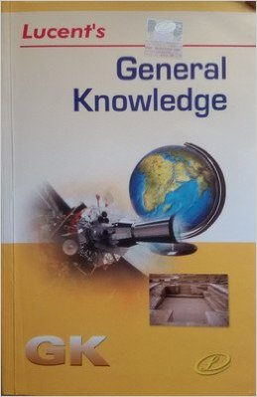

Science- theory?
NCERT
GS Manual (any, even 2nd hand) and LucentGK
7-10 all
11-12 selective
Physics, chemi. Principles-Yes
Trivial GK, advance bio/chem…no
Chem compounds-names – Yes
Disease/nutrients-Yes
Relevant MCQs- yes
Disha Paper set
Last 21 years topicwise Physics, chem, bio qs.
Must read for sci, history (ancient, medieval)
If time permits
Notes:
Blue tooth and wifi?

